Slide 1

HEALTH MANAGEMENT SYSTEM
SRM INSTITUTE OF SCIENCE AND TECHNOLOGY
SCHOOL OF COMPUTING
DEPARTMENT OF COMPUTING TECHNOLOGIES
21CSC203P ADVANCED PROGRAMMING PRACTICE
MINI PROJECT
RA2211003011311 –NAMAN MIDDHA
RA2211003011313 –SHASHANK GHOSH
RA2211003011335 – GAGAN CHETHAN

Slide 2
TABLE OF CONTENTS
•Abstract
•Objectives
•Software Requirements
•Architecture diagram / Block diagram of the modules
•GUI Design
•Database Design
•Future Enhancement

Slide 3
ABSTRACT
A Python-based software program designed for healthy routine
Purpose: To keep track of your routine work
Features:
Maintain accurate records of your daily routine.

Slide 4
OBJECTIVE
Food Tracking:
Allow users to log and track their daily food intake.
Exercise Logging:
Enable users to record their daily physical activities
and exercises.
Medication Management:
Allow users to input and track medications they are
taking.

Slide 5
SOFTWARE REQUIREMENTS
Front End: python
Technologies: Tkinter library in Python
Database: SQLITE
Connectivity: SQLITE-connectivity-Python
Operating System: Windows 10/11

Slide 6
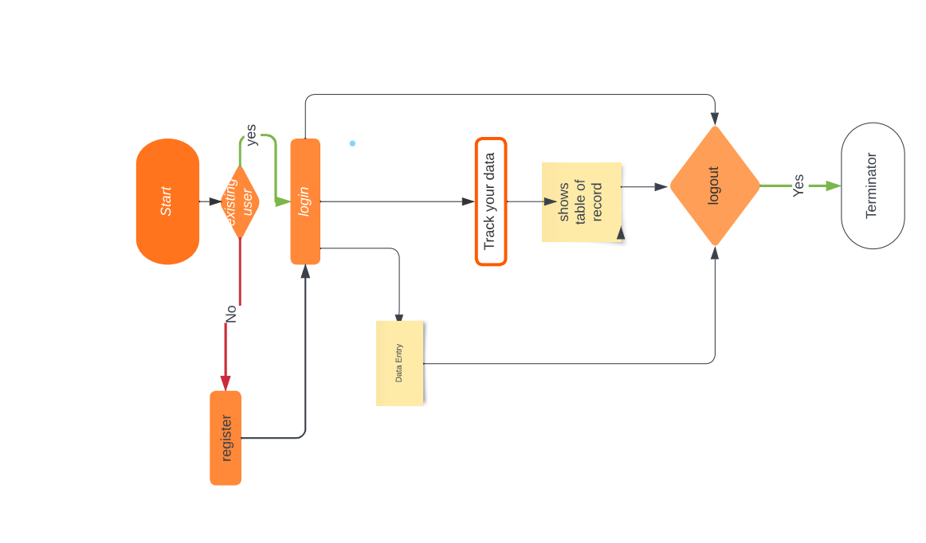
BLOCK DIAGRAM

Slide 7
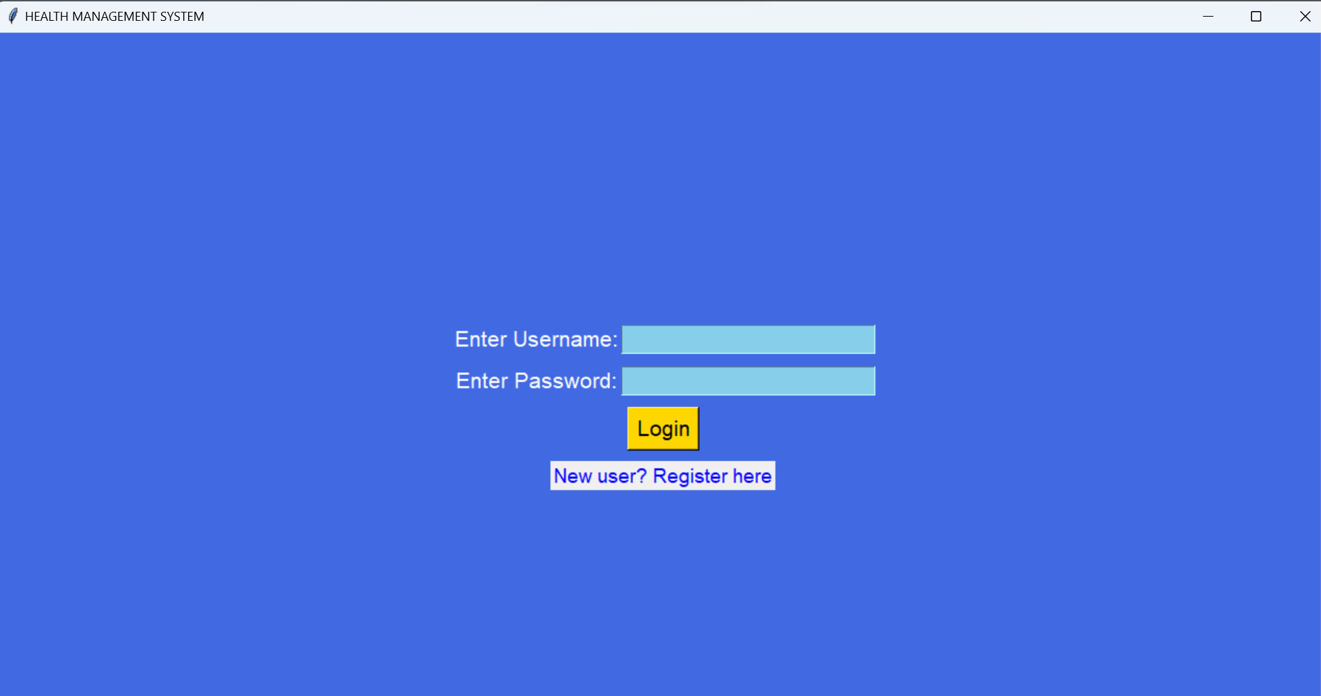
GUI DESIGN
User Login Page

Slide 8
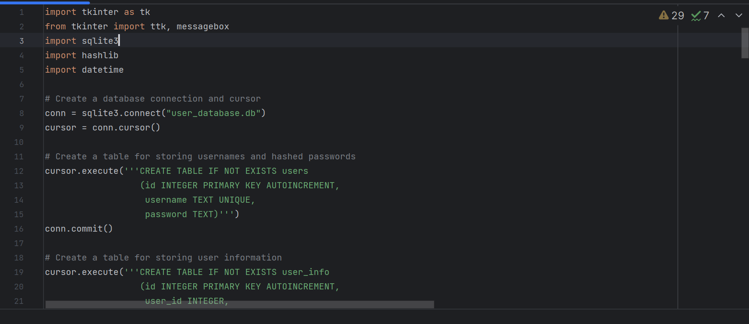
GUI DESIGN
Insight to the code

Slide 9
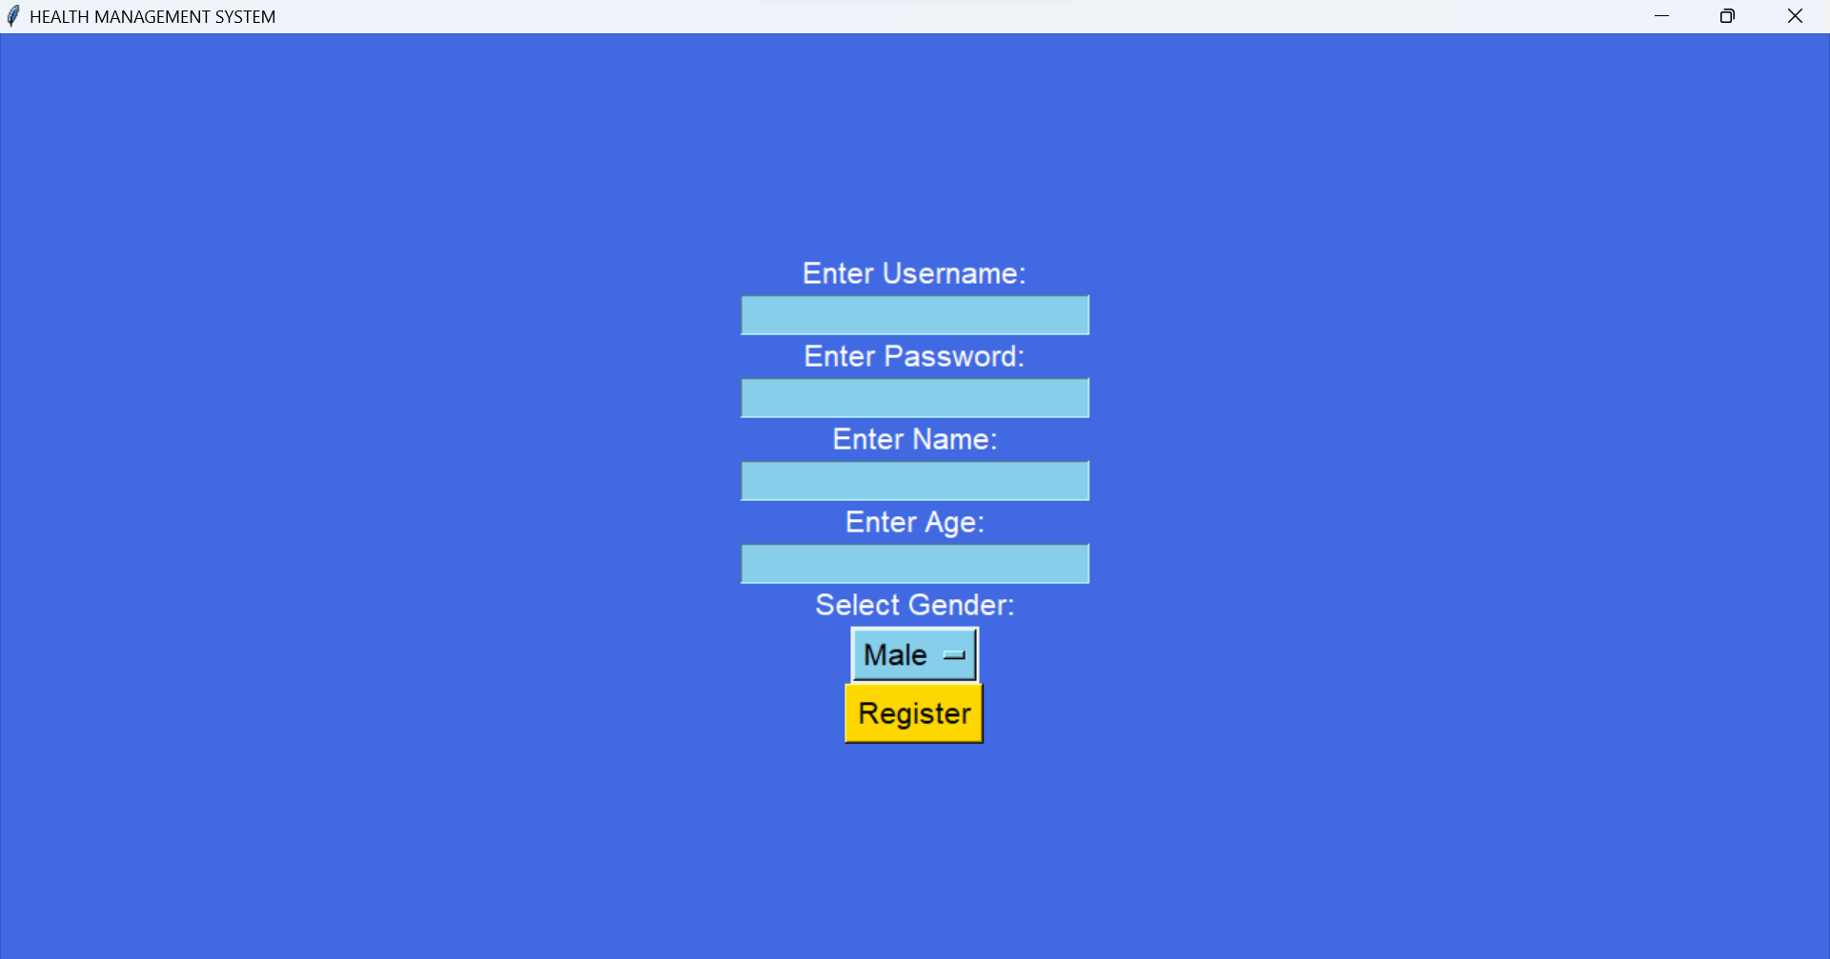
GUI DESIGN
User Sign up Page

Slide 10
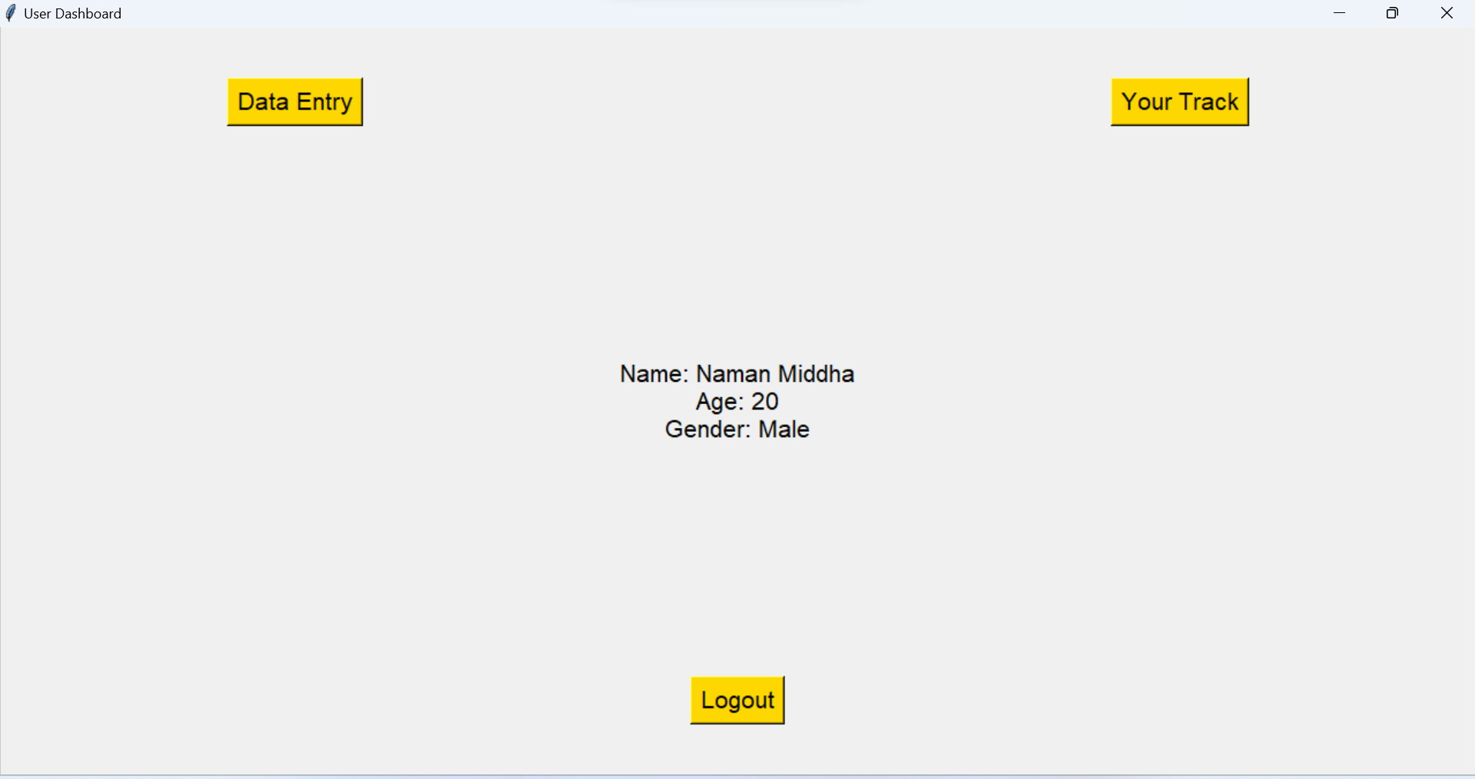
GUI DESIGN
After Login

Slide 11
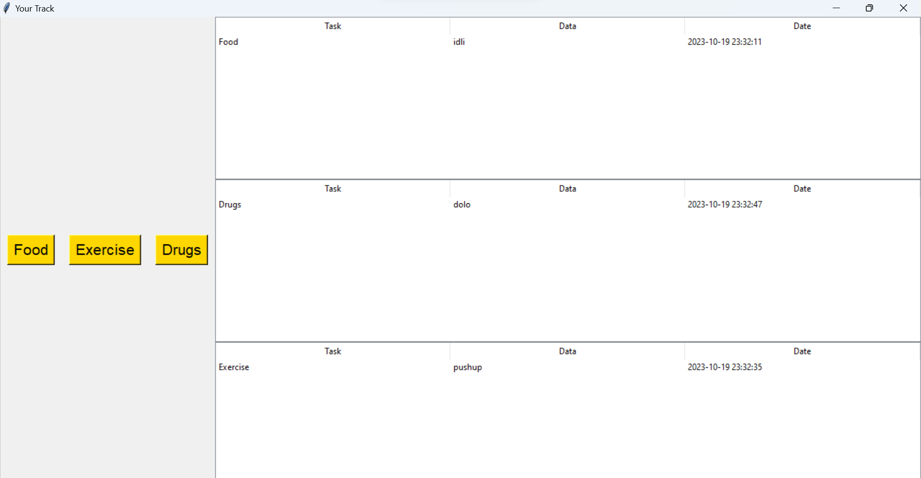
GUI DESIGN
Your Track

Slide 12
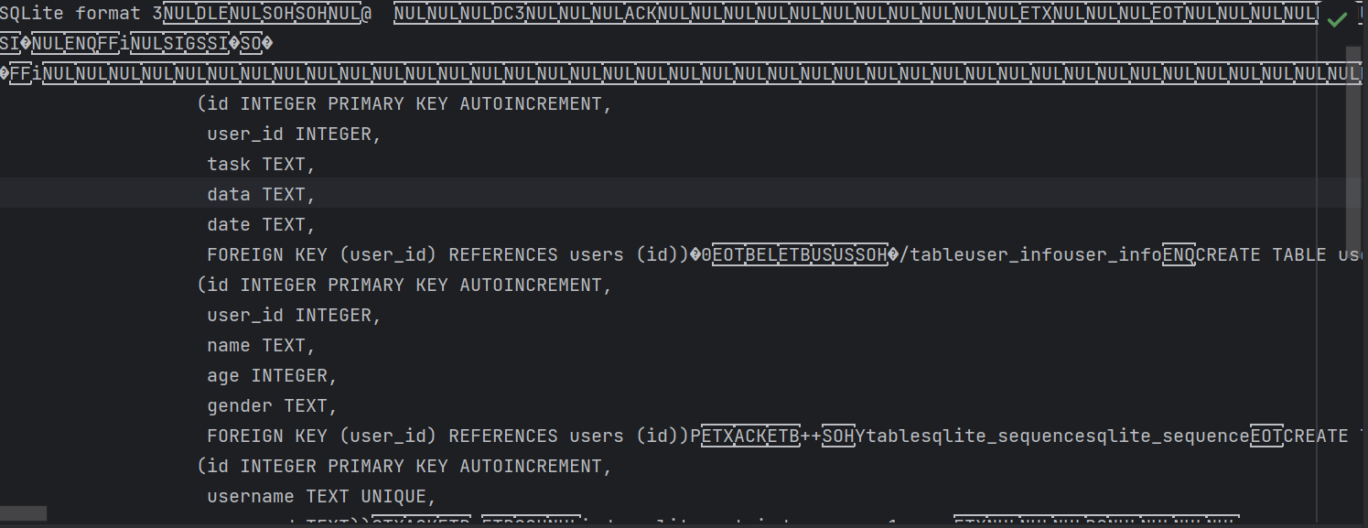
DATABASE DESIGN

Slide 13
FUTURE ENHANCEMENT
Reminder System:
Include a reminder system for users to log their health-related activities regularly.
Allow users to set reminders for medication, exercise, or other health-related tasks.
Data Visualization:
Integrate charts and graphs to visually represent the user's health data trends over time.
Provide insights and analysis of the health data.
Goal Tracking:
Enable users to set health goals (e.g., weight loss, fitness achievements) and track their progress.
Provide motivational features and rewards for achieving goals.

Slide 14
https://github.com/Naman-Middha/SRM/commit/2fc74e5bbc022611aea0eacebb09d2775bcf798a?diff=unified
https://github.com/LUFFY-KIngofCoder/Srm/blob/main/Health%20Management%20sys
https://github.com/GaganChethan

